Slide 1


Sap ABAP on Hana &
s/4hana trainings
Anubhav Oberoy
Day – 7

Slide 2

Agenda – Day 7
Create Fiori App by CDS
Describing CDS Annotations
Object Model Annotations
OData Annotations
Analytical Annotations
End User Annotations
UI Annotations
--Break--
S/4HANA Embedded Analytics
Query Browser
ALP (Analytic List Page )
OVP (Overview Page )
Making CDS DCL ( Authorization and Secure Programming )
Understanding CDS Security

Slide 3
What is OData Service?
OData Stands for Open data protocol, it is best way to expose data over http(s) protocol over network. OData is developed by a company called OASIS and later acquired by Microsoft which made it open source.
Why?
Presentation → Browser/Mobile/Tablet
Fiori Applications
https://www.youtube.com/watch?v=v_xPlRumdbE
https://www.youtube.com/watch?v=zx7NbRN-Chc
SOAP
OData
Application Layer
Expose data over network / internet

Slide 4
How to work with a free odata available on internet for everyone
Service Document – Collection of end points or entities to perform CRUD (Create Read, Update and Delete).
https://services.odata.org/V3/OData/OData.svc/
Metadata document – To check all the available properties which belongs to entities, We have entity type for every entityset. We can use the entity type to show all the properties in metadata.
https://services.odata.org/V3/OData/OData.svc/$metadata
Read an Entity Data (SELECT * FROM dbtab)
https://services.odata.org/V3/OData/OData.svc/Products?$format=json
Read a Single record by key (SELECT SINGLE * FROM dbtab)
https://services.odata.org/V3/OData/OData.svc/Products(1)?$format=json
Read selective columns (SELECT col1, Col2,.. FROM dbtab)
https://services.odata.org/V3/OData/OData.svc/Products?$format=json&$select=ID,Name,Price
Read data chunk by chunk – pagination (SELECT * UP TO ROWS n FROM dbtab)
https://services.odata.org/V3/OData/OData.svc/Products?$format=json&$top=2&$skip=2
Search of data (SELECT * FROM dbtab WHERE condition)
https://services.odata.org/V3/OData/OData.svc/Products?$format=json&$filter=Name%20eq%20%27Milk%27

Slide 5
Getting count of data (SELECT COUNT(*) FROM dbtab)
https://services.odata.org/V3/OData/OData.svc/Products/$count
Load data using association (SELECT * FROM dbtab INNER JOIN dbtab2 ON conditions)
https://services.odata.org/V3/OData/OData.svc/Products(2)?$format=json&$expand=Supplier

Slide 7
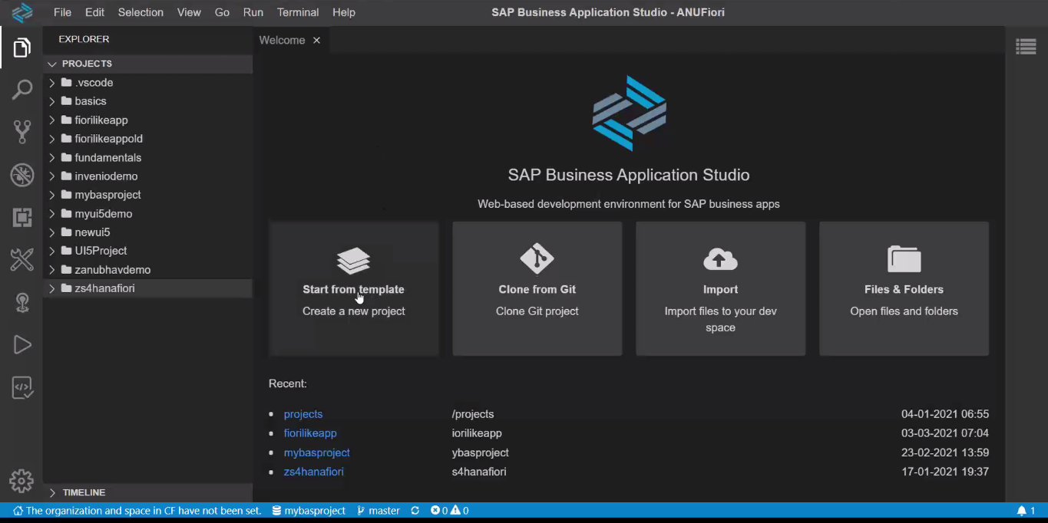
Create Fiori App on top of CDS in BAS
Open Business Application Studio ( BAS )

Slide 8
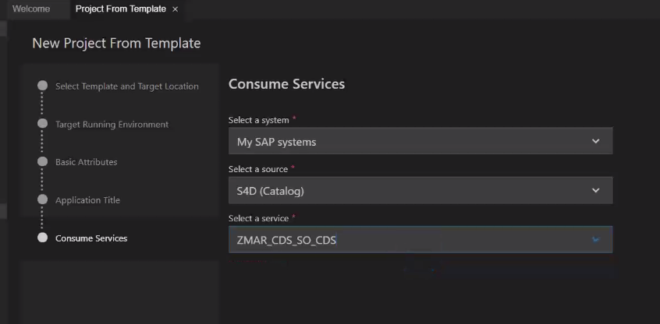
Result : Sales Order Processing App (1)
CDS NAME

Slide 9
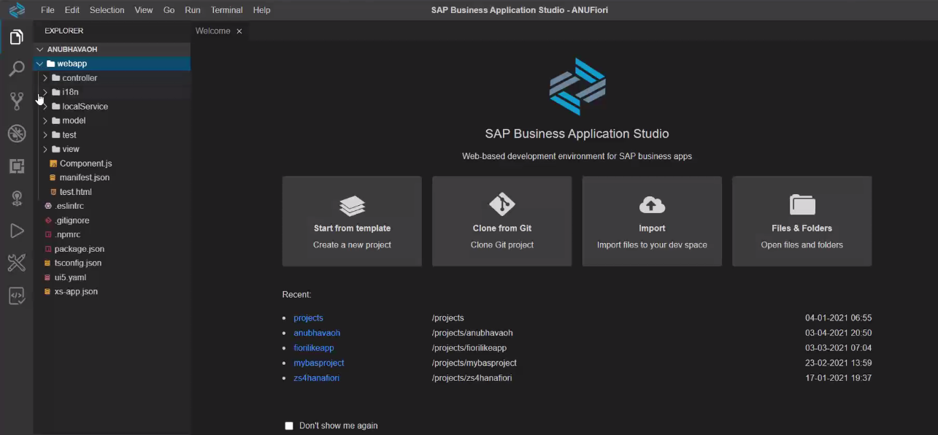
Result : Sales Order Processing App (2)

Slide 10
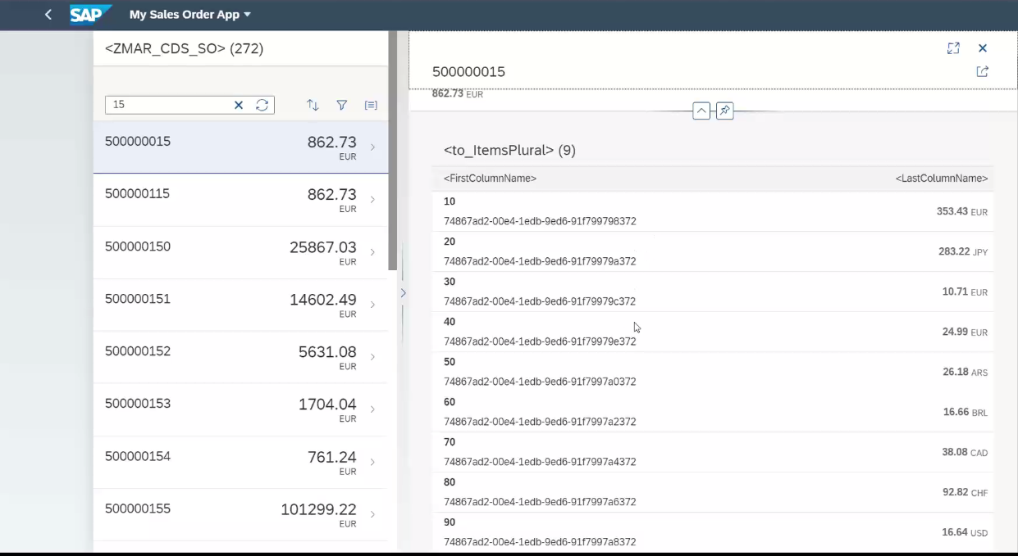
Result : Sales Order Processing App (3)

Slide 11
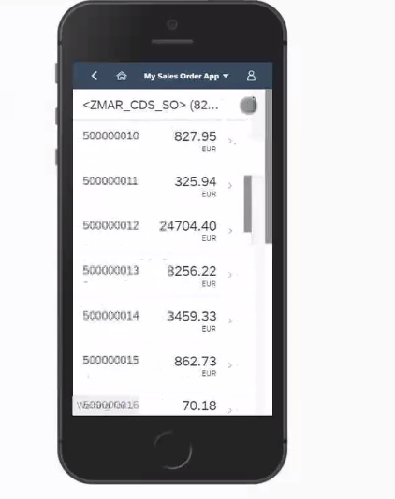
Result : Sales Order Processing App (Responsive )
Make Application Mobile Ready

Slide 12
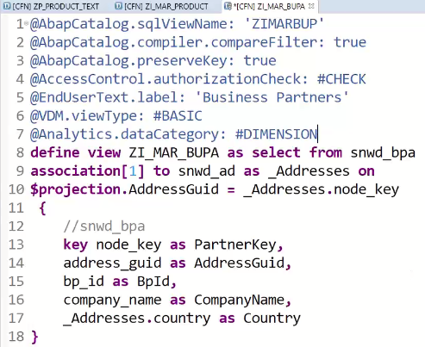
Annotations
Object Model Annotations
01
02
OData Annotations
03
Analytical
Annotations
04
End User Annotations
05
UI Annotations

Slide 13

Data Category Annotations
Annotate the data category as follows:
Plain transaction data as @Analytics.dataCategory: #FACT,
Transaction data containing all relevant fields for data aggregation as @Analytics.dataCategory: #CUBE,
Business documents, configuration and master data including keys and attributes as @Analytics.dataCategory: #DIMENSION,
Language-dependent texts as @ObjectModel.dataCategory: #TEXT,
Hierarchies as @ObjectModel.dataCategory: #HIERARCHY.

Slide 14

Break

Slide 15
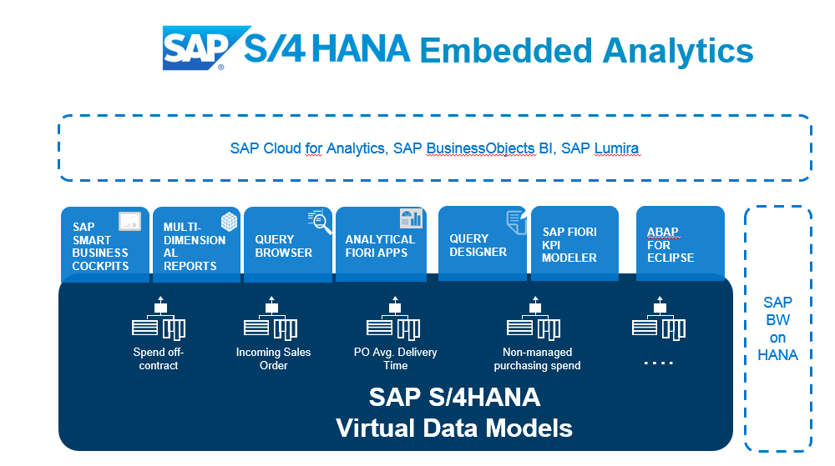
Embedded Analytics
The embedded analytics in SAP S/4HANA provide real-time insights into transactional data. ... With predefined content – visualized in Fiori – the solution offers a kick-start in operational reporting, without the direct need for a separate reporting platform.

Slide 16
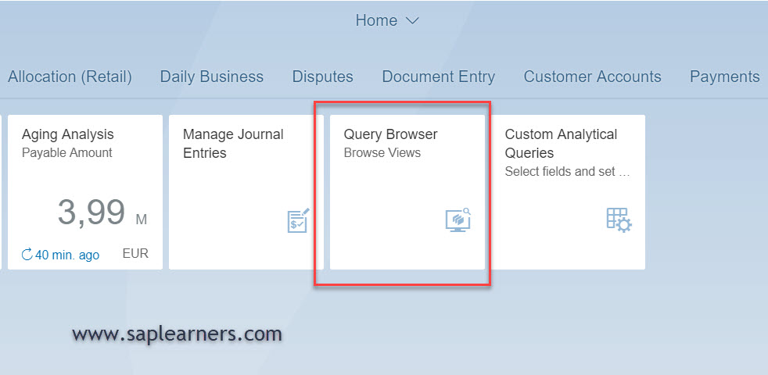
Query Browser
The Query Browser is an SAP fiori application which allows end-user to search for an analytical query and perform ad-hoc reporting on it. The Query Browser is available as a tile in SAP Fiori Launchpad. It displays all the SAP standard analytical queries and custom analytical queries to which the user has access.

Slide 17
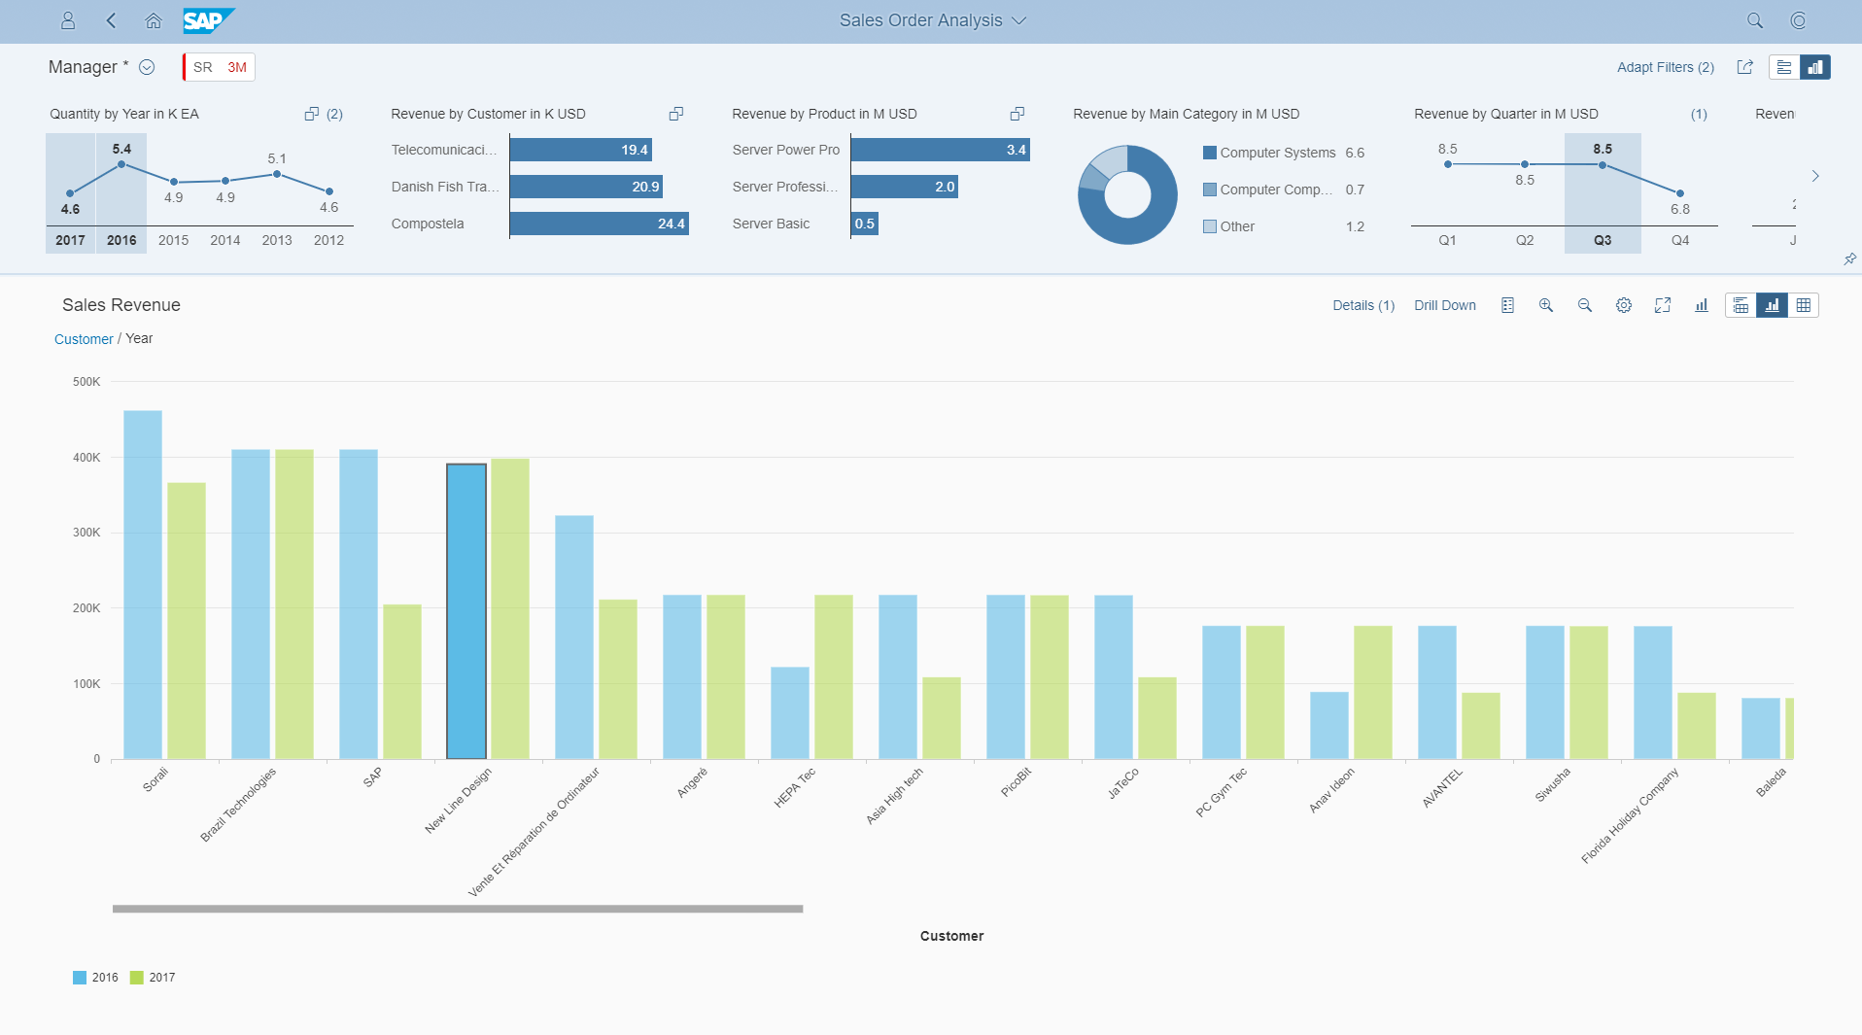
Analytic List Page
Analytical List Page (ALP) is an SAP Fiori elements application for detailed analytics.
ALP lets you analyze data from different perspectives, investigate a root cause, and to act on transactional content. You can identify relevant areas within data sets or significant single instances using data visualization and business intelligence. All this can be done seamlessly within one page.

Slide 18
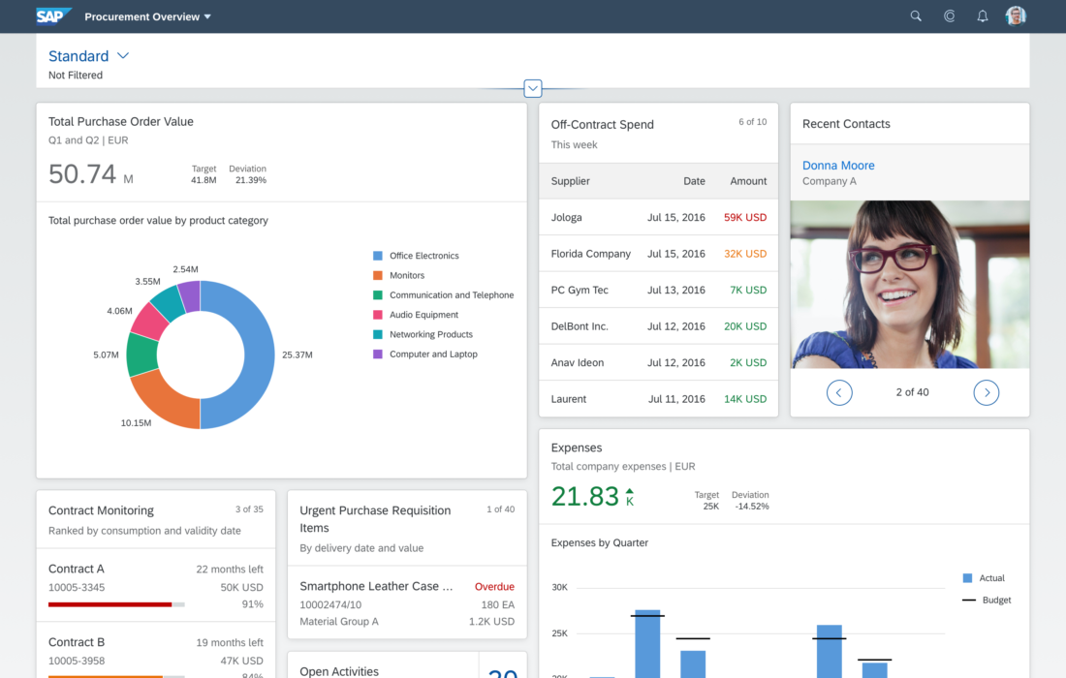
Overview Page ( OVP )
The overview page (OVP) is a data-driven SAP Fiori app type and floorplan that provides all the information a user needs in a single page, based on the user's specific domain or role. It allows the user to focus on the most important tasks, and view, filter, and react to information quickly

Slide 19
CDS Data Control Language ( DCL )
Declarative approach instead of coded
Based on CDS modeling objects and therefore part of the data-model
Authorizations are also pushed down to DB by extending the Open SQL SELECT statement
Authorizations are only defined once and automatically (re-) used everywhere
Classical approach
DCL approach
PFCG
<Code>
PFCG
<Code>
DCL
SQL
&
SQL
ABAP Authorization Check
CDS View
<Code>
<Code>

Slide 20





Authorizations for CDS Views
All CDS views which expose sensitive or data privacy and protection relevant data must be secured.
Access restrictions on record level are expressed by roles in the Data Control Language (DCL).
Authorization enforcements of DCLs are automatically applied for direct ABAP SQL selects on their protected CDS views.
Authorization enforcements of DCLs are injected as additional filter criteria.
If multiple DCLs are defined for a single CDS view the access restrictions are combined by a logical OR (i.e. the access is less restricted than defined by the individual DCLs).

Slide 21

Aspect
An aspect can be used to define user-dependent values which can be compared to one or more columns of the data model
PFCG_AUTH aspect is a pre-delivered aspect that links the object model not to a user attribute but to his ABAP PFCG authorizations
USER aspect can be used to compare the current logged on user with column of the date model

Slide 22
Runtime Behavior
During runtime the SELECT statement for a CDS view will automatically be enhanced with the authorization filter.
SELECT … FROM … INTO …
WHERE … AND <Authorization Filter Condition>
Authorization check
ABAP Database Base
Authorization Object
View fields
DCL
DDL CDS view
User Profile
Notes:
The sole purpose of an R/3 system is to provide a suite of tightly integrated, large-scale business applications. R/3 comes prepackaged with the core business applications needed by most large corporations. These applications coexist in one homogenous environment. They are designed from the ground up to run using a single database and one (very large) set of tables.
Presentation: It is usually installed on a user's workstation. When started, the presentation server displays the R/3 menus within a window. This window is commonly known as the SAPGUI, or the user interface (or simply, the interface).
Basis : Basis is like an operating system for R/3. It sits between the ABAP/4 code and the computer's operating system. SAP likes to call it middleware because it sits in the middle, between ABAP/4 and the operating system. ABAP/4 cannot run directly on an operating system. It requires a set of programs (collectively called Basis) to load, interpret, and buffer its input and output. Basis provides the runtime environment for ABAP/4 programs.
Database: The database server is a set of executables that accept database requests from the application server. These requests are passed on to the RDBMS (Relation Database Management System). The RDBMS sends the data back to the database server, which then passes the information back to the application server. The application server in turn passes that information to your ABAP/4 program.

Slide 23
Which DCL Roles are Evaluated When ?
CDS Views
DCL Roles
ABAP Open SQL
SELECT AttributeB,
AttributeA
FROM VIEW_D
VIEW_D
ROLE_D
AttributeB
_VIEW_A.AttributeA
grant select on
VIEW_D …
Effective: ROLE_D
<<select from>>
SELECT AttributeB,
_VIEW_A.AttributeA
FROM VIEW_C
VIEW_C
ROLE_C
Effective: ROLE_A resp. ROLE_C
AttributeB
Association: _VIEW_A
grant select on
VIEW_C …
<<select from>>
VIEW_B
ROLE_B
SELECT AttributeB
FROM VIEW_B
AttributeB
grant select on
VIEW_B …
Effective: ROLE_B
<<association>>
VIEW_A
ROLE_A
AttributeA
grant select on
VIEW_A …

Slide 24

Exercise 10
CDS Security with DCL.
Notes:
The sole purpose of an R/3 system is to provide a suite of tightly integrated, large-scale business applications. R/3 comes prepackaged with the core business applications needed by most large corporations. These applications coexist in one homogenous environment. They are designed from the ground up to run using a single database and one (very large) set of tables.
Presentation: It is usually installed on a user's workstation. When started, the presentation server displays the R/3 menus within a window. This window is commonly known as the SAPGUI, or the user interface (or simply, the interface).
Basis : Basis is like an operating system for R/3. It sits between the ABAP/4 code and the computer's operating system. SAP likes to call it middleware because it sits in the middle, between ABAP/4 and the operating system. ABAP/4 cannot run directly on an operating system. It requires a set of programs (collectively called Basis) to load, interpret, and buffer its input and output. Basis provides the runtime environment for ABAP/4 programs.
Database: The database server is a set of executables that accept database requests from the application server. These requests are passed on to the RDBMS (Relation Database Management System). The RDBMS sends the data back to the database server, which then passes the information back to the application server. The application server in turn passes that information to your ABAP/4 program.

Slide 25

End of Day 7

Slide 26

Questions

Slide 27

Anubhav Oberoy

Slide 28


We’re committed to empower you to be
Most Desirable Resource
through powerful training solutions.
We build the workforce of the future.
250+
Corporate Clients
30,000+
Learners Trained
25000+
Learners Placed
FREE WEBINARS
Sign up for free webinars with industry experts every fortnight!
Enroll Now!
Contact us today!
https://anubhavtrainings.com/

Slide 29




More from AnubhavTrainings.com

